Slide 1


COVID ACCESS GRANTING SYSTEM THROUGH
FACE MASK DETECTION AND TEMPERATURE
SENSING
Bachelor of Technology
Degree in
Electronics Engineering

Slide 2
KAMLA NEHRU INSTITUTE OF TECHNOLOGY
SULTANPUR-228118
Under Guidance of : Dr. Yogesh Kumar Mishra
(Professor, KNIT Sultanpur) Department of Electronics Engineering
By:
NAME ROLL NO
Shubham Bansal 17469
Jai Prakash Tyagi 17425
Basu Gupta 17420
Aditya Triphati 17406

Slide 3
Content
Abstract
Introduction
Requirement
Block Diagram
Circuit Diagram
Main Working Idea
Application
Conclusion

Slide 4
ABSTRACT
Perhaps one of the most striking lifestyle changes resulting from the COVID-19 pandemic.
So it is the mandatory use of face masks in grocery stores, restaurants, and other public places.
Wearing a mask, especially when near others, is imperative to slowing the spread of COVID-19.
But one look outside of your “safe-at-home” haven and you might find people wearing masks in a variety of different styles: dangling from one ear, pulled down below the nose or resting below the chin.

Slide 5
These common mistakes decrease the effectiveness of masking and increase the wearer’s risk of catching and spreading the disease.
Many people who have COVID-19 do not show symptoms but can still spread the virus through droplets that escape from the mouth when speaking, sneezing, and coughing.
Scientists have proven that masking lowers COVID-19 cases, even in the long term.
As we approach back-to-school season, public knowledge of proper masking technique is now more important than ever.

Slide 6
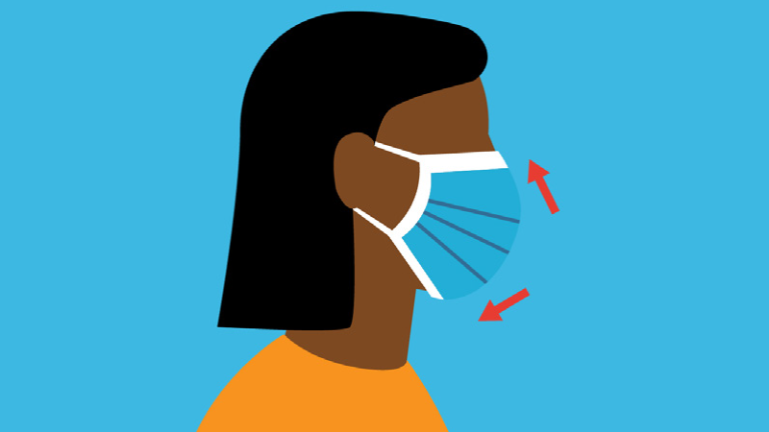
INTRODUCTION
As we are aware that the world is facing a global pandemic .
everyone needs to follow proper personal hygiene, wearing masks and maintain social distance in public areas to curb the spread of this deadly Sars-COVID 19 virus.

Slide 7
This virus is very dangerous as it spread from one person to another person if an infected person is near a healthy person.
We have designed a system through which we will check at the entrance of places like shopping malls, cinema halls, supermarkets.
A person is wearing mask or not and his body temperature is normal or not .
Both of these conditions satisfies that is the person is wearing mask and his body temperature is normal .
Then only he will be given access to the place otherwise he will be denied access so as to ensure the safety of other persons.

Slide 8
REQUIREMENTS
OpenCV
TensorFlow
Arduino
Temperature Sensor
Camera Module
ZigBee
Python

Slide 9
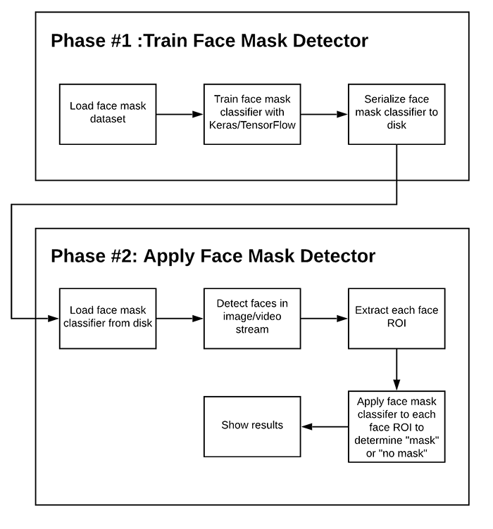
BLOCK DIAGRAM

Slide 10
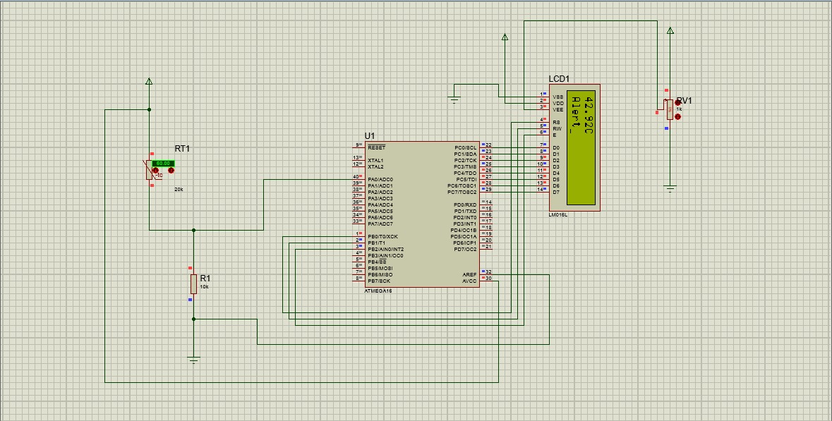
CIRCUIT DIAGRAM

Slide 11
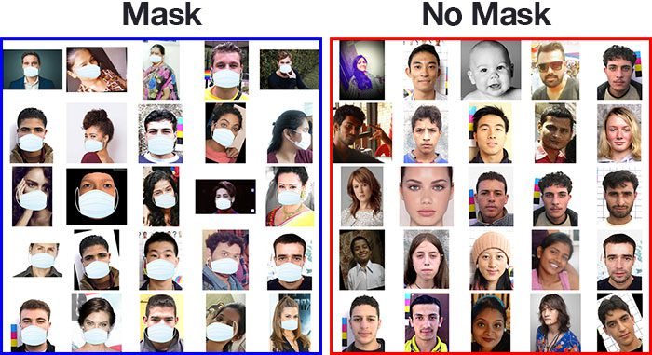
Dataset used The dataset we are working on consists of 1376 images with 690 images containing images of people wearing masks and 686 images with people without masks.

Slide 12
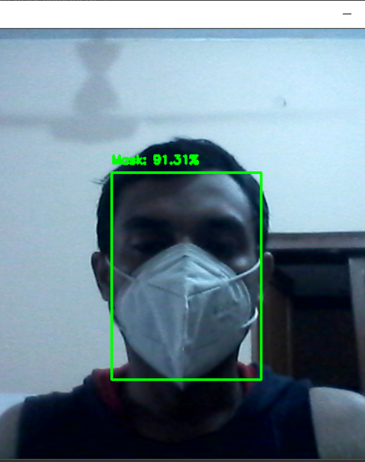
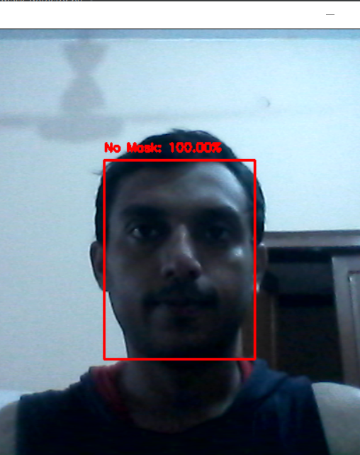
OUTPUT

Slide 13
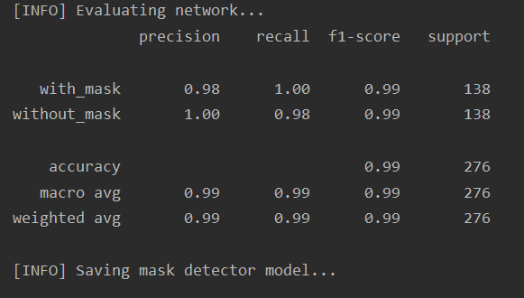
Result OF TRAINING THE MODEL

Slide 14
MAIN WORKING IDEA
We have divided this project into four parts-
To make a neural network model which can detect if a person is wearing a face mask or not.
As this problem is a binary classification problem.
So we need to employ supervised machine learning and design a
convolution neural network model which will give two output that is
a person wearing a mask or without mask.
For this we have taken dataset from internet which is having image with
person wearing mask and without masks trained our model on these
image

Slide 15
To use our face mask detection model real time . We will use OpenCV
to and camera module to capture frame of a person at the entrance
and then using our model will decide if the person wearing mask or not.
If he is wearing mask our python code will give output as true otherwise
it will give output as false.
To detect the temperature of the person at the entrance . We will use the
temperature sensor to detect if person ‘s temperature is normal or not.
If the temperature is above 100 C . It will generate output as true.
We will use the AND logic and only grant access if both the condition are
true that is if the person is wearing a mask and if his body temperature is
normal then he is granted access otherwise he is not granted access.

Slide 16
APPLICATION
Entry Gate of public places like metro station, railway stations, supermarkets.
Entry Gate of offices and classrooms to ensure that employees and students are wearing mask and they are asymptomatic
To stop the spread of Covid-19 in public places as any person suffering from Covid-19 at that place may act as a super-spreader.

Slide 17
CONCLUSION
This system can be very effective for monitoring and controlling the spread of COVID-19 virus. It can check if a person is following proper hygiene of wearing mask and if he is not having any symptoms related to COVID-19. This will ensure that the virus does not spread in the community through these public places and social gatherings.

Slide 18
Thank you

